Slide 1
St. FX Teaching Retreat
Designing and Planning
Teaching and Learning Spaces

Slide 2
Teaching and Learning Spaces
Schwartz School
Renovation process
Five years experience
Various approaches to teaching including:
Case analysis discussion,
Problem-based learning,
Lecturing
Group-based learning in and out of class,
Virtual business simulation
Classes of 40-60 students

Slide 3
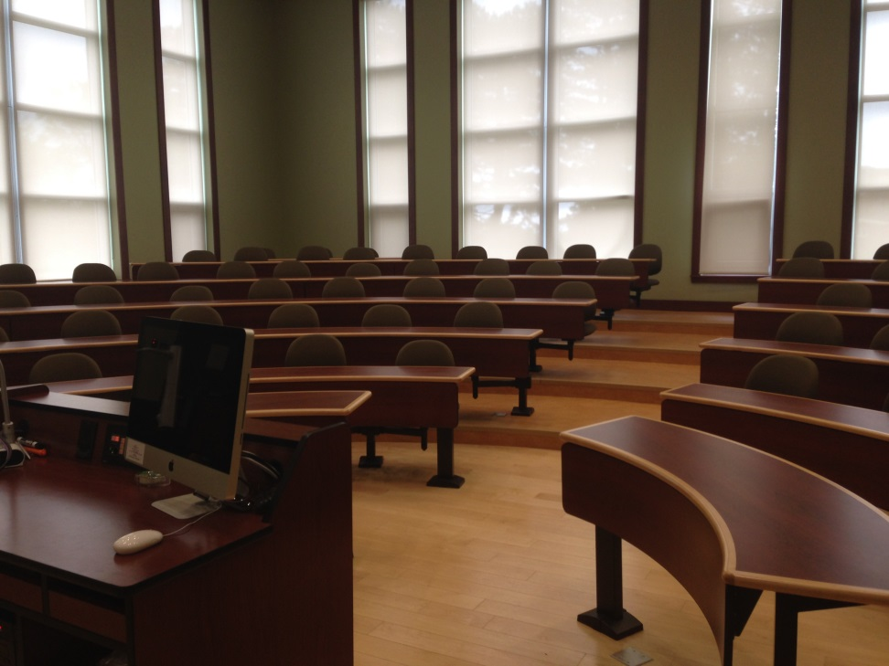
Schwartz Classrooms
4 rooms with seating for ~ 80-100
U-shaped (Harvard and Ivey case-method layout),
Tiered,
Staggered seats,
Fixed tables,
Pathways
3 rooms with seating for ~ 30 and moveable tables/chairs to create multiple layouts

Slide 4
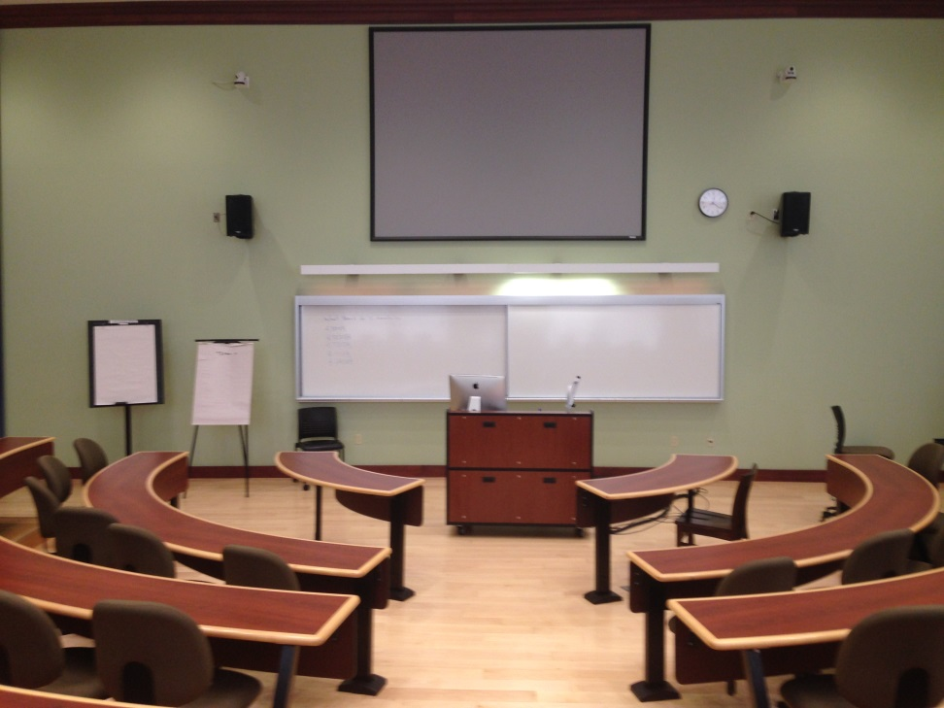
Schwartz Classrooms
Presentation Space
Moveable podium
Portable microphone
Cascading whiteboards
Projector screen
Various projection modes: PPT, Internet, video, TV, document camera

Slide 5
Physical Layout
Engagement
Proximity
Accessibility
Interaction
Prof and students
Students and students
Entrances to all classrooms at front

Slide 6
Visibility and Acoustics
Visibility
Generally good eye lines with U-shape, staggered seats and tiers
Swivel chairs enable students to see each other
Simultaneous presentation options
Acoustics
Some reverberation
Challenging with quiet talkers
Portable microphones
Students’ questions & answers

Slide 7
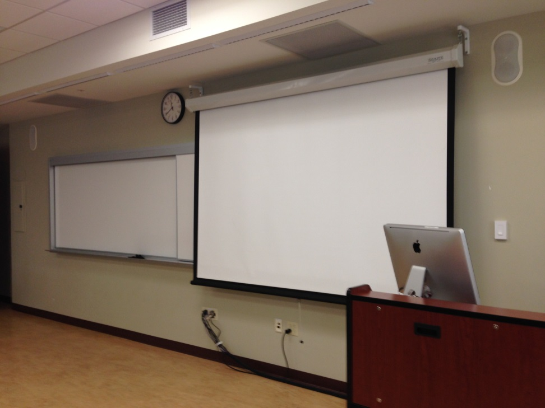
Visibility
Challenges
Low-ceiling rooms and multi-media
SCHW 290 screen covers part of the whiteboard
Projector shines in your eyes

Slide 8
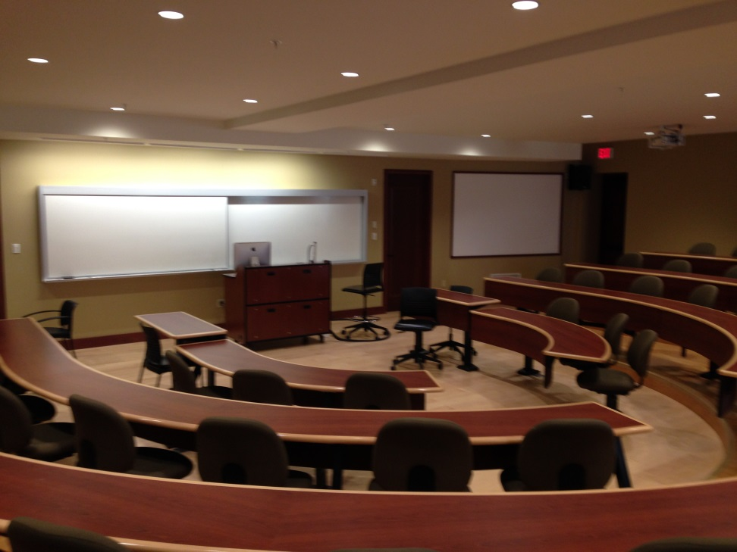
Visibility
Challenges
Low-ceiling rooms and multi-media
SCHW 152 screens on either side of whiteboard
Entrances by display screens

Slide 9
Visibility
Window treatments
Videos and websites during early morning in SCHW 215 and late afternoon in SCHW 156 and 205

Slide 10
Student Space in Classroom
Tables and chairs are effective
Space for group work, laptops, notes & books
Swiveling chairs for case discussions and group work
Insufficient power outlets for student technology
Name-holder slots in table
One classroom with ten dedicated breakout rooms linked by centralized audio/visual technology

